Slide 1

The magazine “CULTURE, NATION” activity during 2013-2017
Natalia Barkar
CAS Annual Conference at the Ryerson University
May 27, 2017
(Toronto, Ontario)

Slide 2
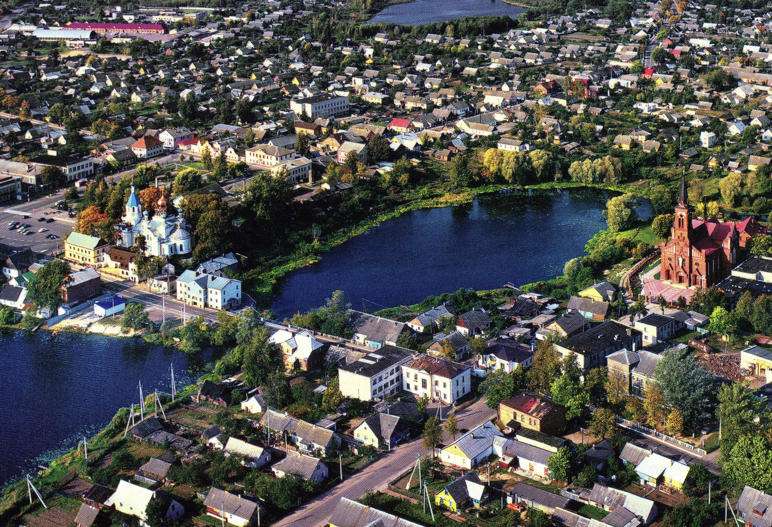
“Culture, Nation”
History, Language, Belarusians, State
Pastavy. ПАСТАВЫ. Image by S. Plytkevich

Slide 3
“CULTURE, NATION”
Editorial Board
Editor and Founder Piotra Murzionak
Board members :
Natalia Barkar
Wolga Ipatava
Viktoryja Kazlova
Sjarhei Paniznik
Halina Tumilovich

Slide 4
“CULTURE, NATION” www.sakavik.net
During 4 years and 3 months about 800 hundreds posts were published
Topics:
Advertisements, Personals, Enlightment/Education, Magazine's Library, History, External affairs, Culture, Literature, Morality, Language, Nation, Belarusians, project “Together” ("РАЗАМ"), Religion, Editorial, Theatre, Ethnocide of Belarusians.

Slide 5
General web-site activities www.sakavik.net
 | 2013 | 2014 | 2015 | 2016 | 2017 (3 months) | Total | Per year
Visitors | 1819 | 3976 | 4373 | 3782 | 1021 | 14971 | ≈3600
Views | 5480 | 7610 | 7104 | 6112 | 1797 | 28103 | ≈6740
Views per visitor | 3.0 | 1.91 | 1.62 | 1.62 | 1.76 | 1.9
Posts published | 90 | 217 | 210 | 241 | 39 | 797

Slide 6
Number and proportion of views by countries
Country | 2013 | 2014 | 2015 | 2016 | 2017 (3 months) | Total | %
Belarus | 2825 | 3892 | 4245 | 3745 | 1070 | 15777 | 56.1
Canada | 1264 | 1061 | 637 | 558 | 212 | 3742 | 13.3
Russia | 78 | 645 | 592 | 477 | 104 | 1896 | 6.7
USA | 437 | 458 | 385 | 413 | 126 | 1819 | 6.5
Poland | 281 | 139 | 80 | 119 | 32 | 651 | 2.3
Ukraine | 48 | 273 | 123 | 99 | 99 | 642 | 2.2
Germany | 103 | 145 | 106 | 96 | 14 | 464 | 1.7
Brasilia | 0 | 159 | 170 | 96 | 0 | 425 | 1.5
EU | 29 | 169 | 144 | 48 | 6 | 396 | 1.4
Lithuania | 78 | 75 | 92 | 64 | 6 | 315 | 1.1
Chech | 46 | 90 | 26 | 46 | 7 | 215 | 0.8
UK | 20 | 44 | 45 | 17 | 17 | 143 | 0.5
Australia | 57 | 24 | 16 | 5 | 9 | 111 | 0.4
Latvia | 23 | 23 | 30 | 31 | 4 | 111 | 0.4
 |  |  |  |  | Other: | 2048 | 7.3%

Slide 7
Magazine “CULTURE, NATION”
The magazine presents original analytical articles, essays, discussions and comments on history, language, literature, sociology, traditions, and other topics related to the development of the Belarusian nation.
Belarusian language is the preferred language of the magazine; however, materials in other languages have also been published.
The magazine “CULTURE, NATION” is published once in three months.

Slide 8
Magazine “CULTURE, NATION”
During 2013-2017, seventeen (17) issues of the magazine were published
Involving twenty three (23) authors
and eighty four (84) articles.

Slide 9
Magazine “CULTURE, NATION”
on-line Skype discussion was organized regarding “The Nation-Building in Post-soviet Countries: Commonalities and Differences”.
Statistical studies regarding an estimation of Belarusians' population in diaspora and migration processes of Belarusians to Canada
“The Strategy of the Belarusian Nation Development”
The magazine created the Slides Library “BELARUS FOREVER” and more than 60 information bulletens

Slide 10

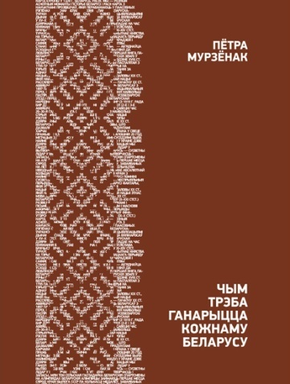
Magazine “CULTURE, NATION”
Based on the magazine information two books were published in Belarus by Editor of magazine:
“The Ways to Belarusian Nation”, Minsk, 2016, 344pp.“
What Each Belarusian Should Be Proud With”, Minsk, 2017, 96 pp.

Slide 11
Magazine “CULTURE, NATION”
The problems and tasks:
We are searching a support from Belarusian community in the web-magazine activities and we expect substantial improving in the work of editorial board as well as our readers.
The number of comments are quite low which might be explained as by traditional “pamjarkounast” of Belarusians as by existence of multiple web-sites and blogs where we have to compete for the space.

Slide 12
Thank you.
Questions ??!!
Contacts:
www.sakavik.net
chasopis.sakavik@hotmail.com

